Slide 1
Probabilistic Fortnite Simulations
CMSE 201
Grant Wiese
12/6/2020

Slide 2
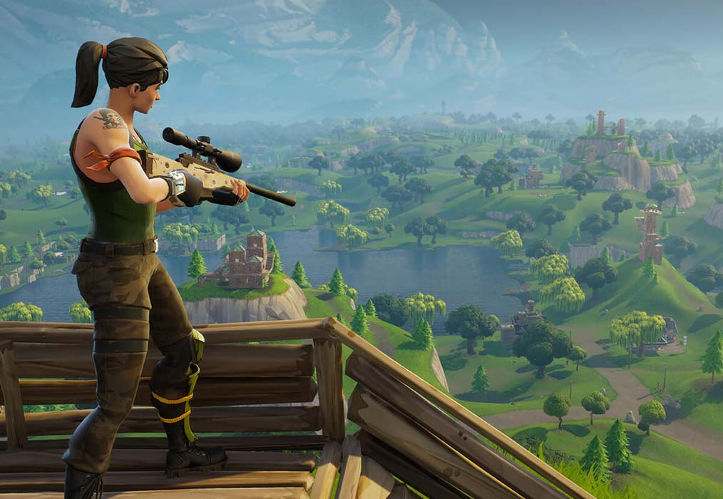
Motivation: Why?
Demonstration of simulation in python
How can one realistically increase their skill over a given time?
There is going to be no code in this presentation

Slide 3
Research Objectives
Is simulating Fortnite games possible? What are its limitations?
How do player statistics change game outcomes?
How does skill change player outcomes? Can skill change over time?

Slide 4

Is Simulating a Fortnite Game Possible? What are its limitations?

Slide 5
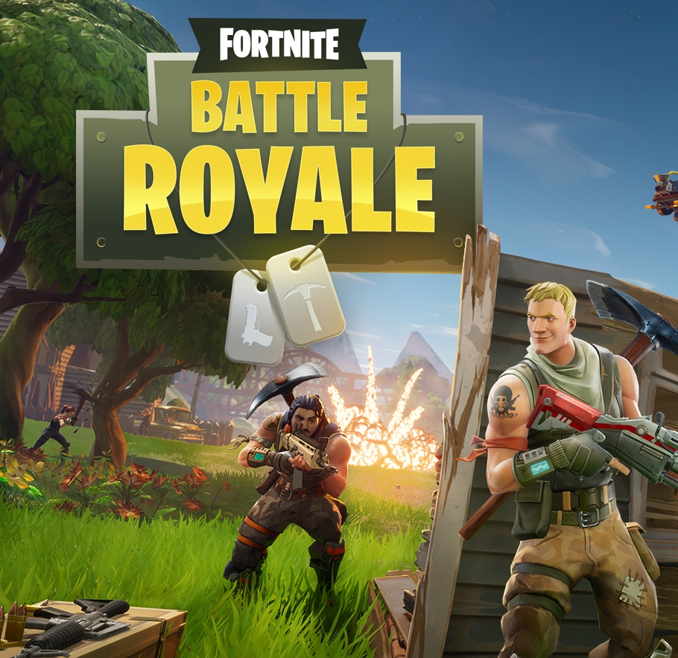

What is Fortnite?
Online videogame where 100 players spawn on an island.
As players find gear and explore, they eliminate each other and try to be the last player left standing.
Fortnite has multiple modes, however this project focuses on solo games.

Slide 6
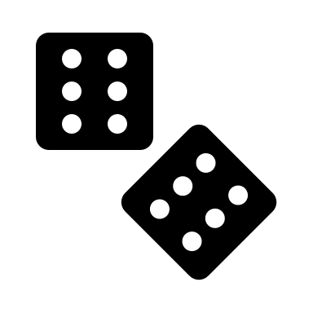
How would a simulation even work?

Slide 7
A High Level View
Set Player Skill and Experience
Generate 99 other players with pseudo-random skill levels
Randomly match up players into pairs and based off skill then eliminate one player from each pair
Repeat until there is one player left
Return the winner of the simulation
What exactly does player skill mean?
How do you generate this?
How do you eliminate players?
Repeat many times

Slide 8

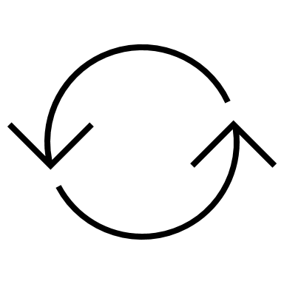

A High Level View
Set Player Skill and Experience
Generate 99 other players with pseudo-random skill levels
Randomly match up players into pairs and based off skill then eliminate one player from each pair
Repeat until there is one player left
Return the winner of the simulation
What exactly does player skill mean?
How do you generate this?
How do you eliminate players?
Repeat many times
Accuracy
α
Fortnite Games Played
σ
FPS Games Played
Δ

Slide 9
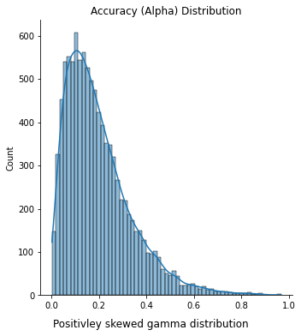
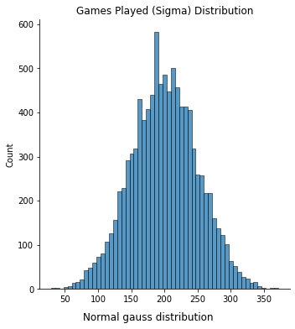
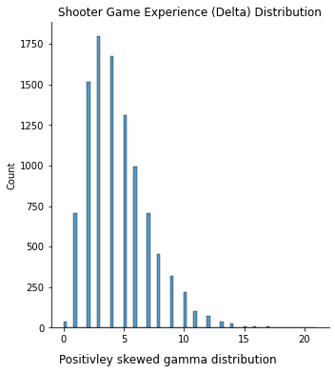
A High Level View
Set Player Skill and Experience
Generate 99 other players with pseudo-random skill levels
Randomly match up players into pairs and based off skill then eliminate one player from each pair
Repeat until there is one player left
Return the winner of the simulation
How do you generate this?
How do you eliminate players?
Accuracy
Fortnite Games Played
FPS Games Played
Repeat many times

Slide 10
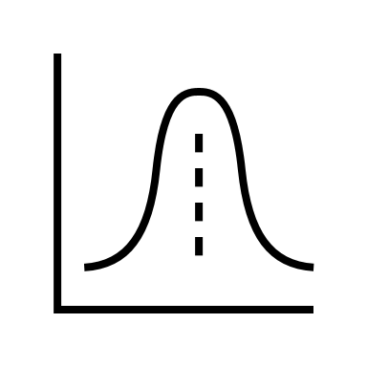
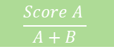
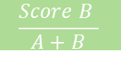
A High Level View
Set Player Skill and Experience
Generate 99 other players with pseudo-random skill levels
Randomly match up players into pairs and based off skill then eliminate one player from each pair
Repeat until there is one player left
Return the winner of the simulation
How do you eliminate players?
Repeat many times
Player A Params
Player A Score
$$\frac{Score A }{A+B}$$
Equation
Randomchoice
Winner
Player B Params
Player B Score
$$\frac{Score B }{A+B}$$

Slide 11
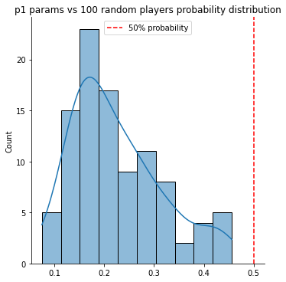
A High Level View
Set Player Skill and Experience
Generate 99 other players with pseudo-random skill levels
Randomly match up players into pairs and based off skill then eliminate one player from each pair
Repeat until there is one player left
Return the winner of the simulation
How do you eliminate players?
1% Shots hit
Repeat many times
200 games played
1 other FPS

Slide 12
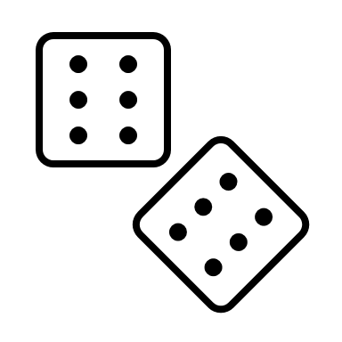
A High Level View
Set Player Skill and Experience
Generate 99 other players with pseudo-random skill levels
Randomly match up players into pairs and based off skill then eliminate one player from each pair
Repeat until there is one player left
Return the winner of the simulation
Repeat many times
+1 to Fortnite experience

Slide 13

How do player statistics change game outcomes?

Slide 14
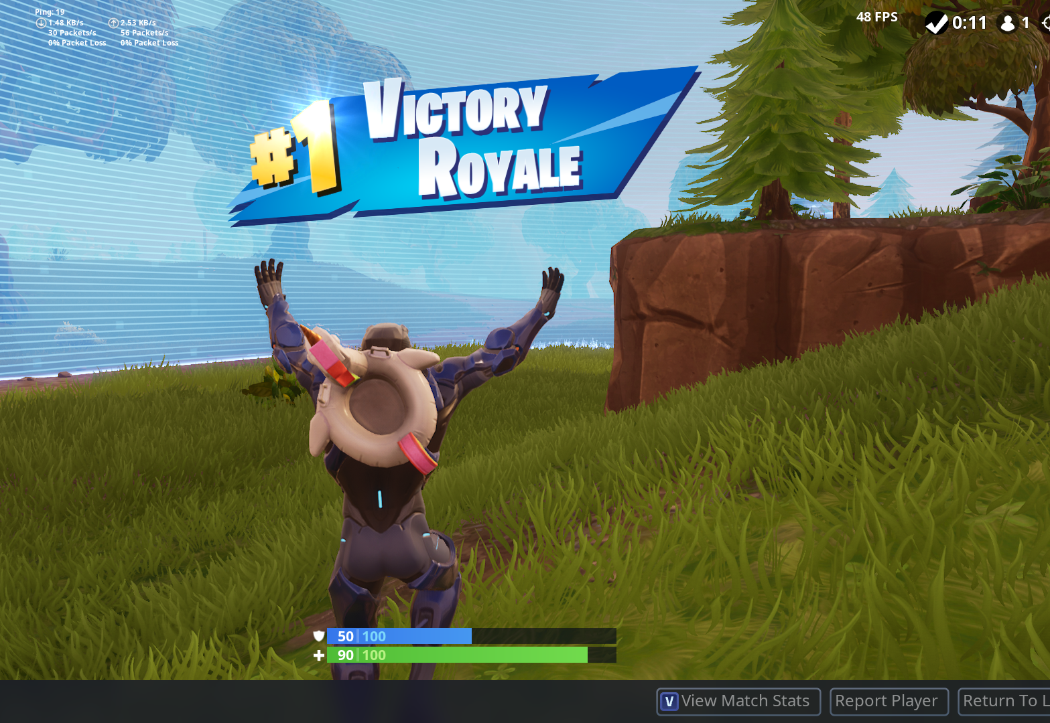

What are we looking for?
The probability of winning after n simulations
The mean minimum simulations it takes to win a game.

Slide 15

Setting up the sim
Set two player parameters, create an array of the third parameter
For each value in the third parameter array, simulate n rounds and return the fraction of rounds won over the total # of simulations

Slide 16
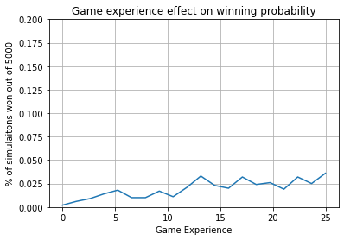
Games played set to 250 with normal growth
20 samples of FPS experience from 0 to 25
Accuracy set to .15
1000 simulations per accuracy sample
20000 simulations
Note: Variance in total simulations to reduce computation time. 1000000+ simulations can take 20+ min on my computer!

Slide 17
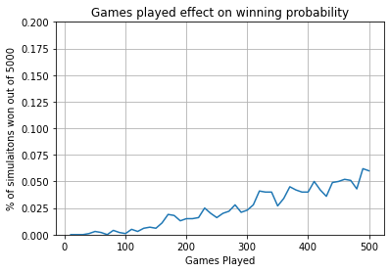
50 samples of 0 to 500 games played
5 FPS experience
Accuracy set to .15
1000 simulations per accuracy sample
50000 simulations

Slide 18
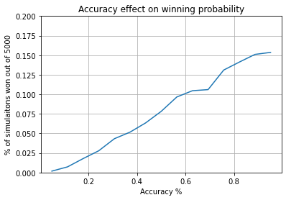
Games played set to 250 with normal growth
5 FPS experience
15 accuracy% samples
5000 simulations per accuracy sample
75000 simulations

Slide 19
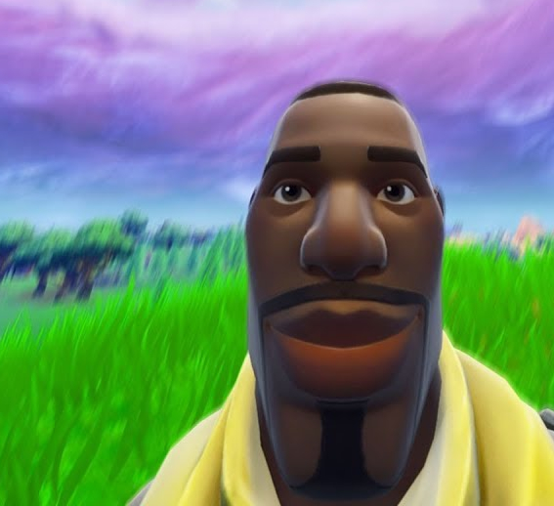
Finding minimum games to get a win
Need to retool simulation functions in order to quit when the player has won one simulation.
Repeat this many times to get a distribution of minimum games
However, player parameters remain static

Slide 20
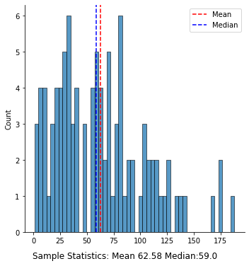
- Initial player parameters .3 Accuracy, 100 Previous games Played, 5 game experience - 100 iterations of “sim till win” - We can say with these parameters, it would take about 62.58 simulations to have a 50% chance at winning a game
Normal Player Params

Slide 21
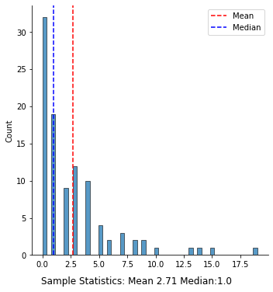
- Initial player parameters .7 Accuracy, 400 Previous games Played, 11 game experience - 100 iterations of “sim till win” - We can say with these parameters, it would only take 1-3 games to win once
Skilled Player Params

Slide 22

How does skill change player outcomes? Can skill change over time?

Slide 23
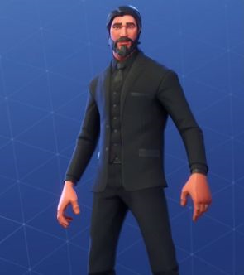
Measuring skill gain over simulations?
We know that every simulation that the player plays, +1 is added to the player’s total games played.
Keep track of when the player was eliminated every simulation
Players should have on average slightly higher placements every game

Slide 24
Setting up the sim
Average hit percent with low Fortnite experience
300 simulations, graph of placement each sim

Slide 25
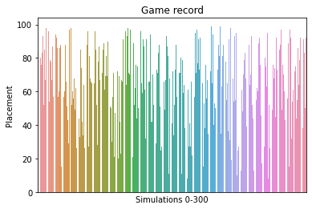
The graph
Very messy graph, it doesn’t seem that there is a correlation
Cant group bins without mis-representing data
Fit a regression model to check correlation

Slide 26
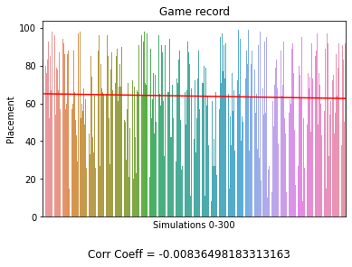
The graph
Nonexistent correlation coefficient
Agrees with previous findings of relative importance of games played on winning %
Noisy data could be normalized with z scores

Slide 27
Conclusions
Is simulating Fortnite games possible? What are its limitations?
How do player statistics change game outcomes?
How does skill change player outcomes? Can skill change over time?

